Slide 1

Basic Details of the Team and Problem Statement
Ministry/Organization Name/Student Innovation:
PS Code: SIH 1382(Ministry of Himachal Pradesh)
Problem Statement Title: Real-Time Vehicle Tracking system.
Team Name: Path 4o5
Team Leader Name: Kartikeya Dhasmana
Institute Code (AISHE): C-21323
Institute Name: Govind Ballabh Pant Institute of Engineering and Technology
Theme Name: Smart vehicle

Slide 2
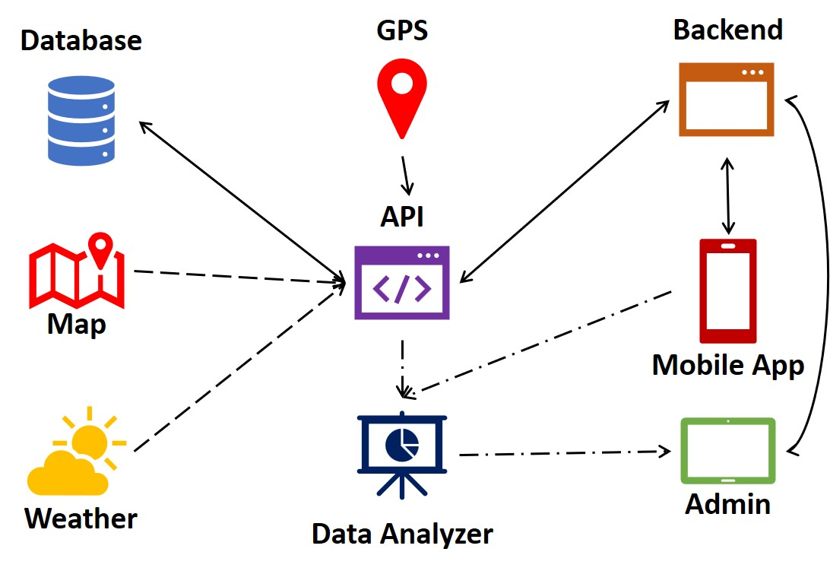
Idea/Approach Details
Describe your idea/Solution/Prototype here:
The proposed smart transportation system for Himachal Pradesh aims to provide real-time information to users regarding bus availability and upcoming timings.
Real-Time Bus Tracking: GPS devices on buses transmit location and speed data to a centralized database.
Mobile App: A user-friendly app for Android which provides real-time bus information.
User Registration: Users register with their mobile numbers for personalized services.
Bus Stop Information: App displays a map with bus stop locations and real-time bus arrivals.
Estimated Arrival Time: App calculates and shows estimated bus arrival times.
Describe your Technology stack here:
GPS
Data Analytics
Emission tracking system
Mobile app to access real time information
Google Maps and Google Weather

Slide 3
Idea/Approach Details
Describe your Dependencies / Show stopper here
Describe your Use Cases here
GPS Infrastructure:
Ensure reliable GPS devices are installed on all buses for real-time tracking.
Data Connectivity:
Rely on a robust, continuous data network for transmitting real-time bus location data.
Data Analytics:
Implement data analytics tools to process and analyze collected data for accurate bus arrival predictions.
Notification System:
Create a notification system to inform passengers of bus arrivals, delays, or schedule changes in real-time.
SHOW STOPPERS:
Lack of GPS Coverage:
Potential accuracy issues in areas with poor or no GPS coverage.
Data Connectivity Issues:
Frequent network outages or weak connectivity can disrupt real-time data transmission, impacting system reliability.
Real-Time Bus Tracking: Users can track the real-time location of buses on a map.
Bus Arrival Time Prediction: The system provides estimated arrival times of buses at specific bus stops.
Traffic Updates: Users receive real-time traffic updates.
Bus Stop Information: Passengers can access information about nearby bus stops, routes etc.
Notifications: Users receive notifications about bus arrivals, delays, or changes in schedules via mobile apps or SMS.

Slide 4
Team Member Details
Team Leader Name: Kartikeya Dhasmana
Branch :Btech Stream: ECE Year: 3rd
Team Member 1 Name: Guarav Bhatt
Branch :Btech Stream : CSE(AI/ML) Year : 3rd
Team Member 2 Name: Akhil Kothari
Branch :Btech Stream : ECE Year : 3rd
Team Member 3 Name: Animesh Naithani
Branch :Btech Stream :ECE Year : 3rd
Team Member 4 Name: PrabhSimran Singh
Branch :Btech Stream :CSE(AI/ML) Year : 4th
Team Member 5 Name: Ankita Kotnala
Branch :Btech Stream: CSE(AI/ML) Year : 3rd
Team Mentor 1 Name: Type Your Name Here
Category (Academic/Industry): Expertise (AI/ML/Blockchain etc.): Domain Experience (in years):
Team Mentor 2 Name: Type Your Name Here
Category (Academic/Industry): Expertise (AI/ML/Blockchain etc.): Domain Experience (in years):

Slide 5
Important Pointers
Please ensure below pointers are met while
Kindly keep the maximum slides limit to 4 pages
All the topics should be utilized for description of your idea
Try to avoid paragraphs and post your idea in points
Keep your explanation precisely and easy to understand
Idea should be unique and novel. If it has a business potential more weightage will be given.
Apart from this PPT abstract of your idea will be asked separately while submitting
You need to save the file in PDF and upload the same on portal. No PPT, Word Doc or any other format will be supported
You can delete this slide (Important Pointers) when you upload the details of your idea on SIH portal.

